Slide 1
μMudd MkV
Christopher Ferrarin and Kaveh Pezeshki

Slide 2
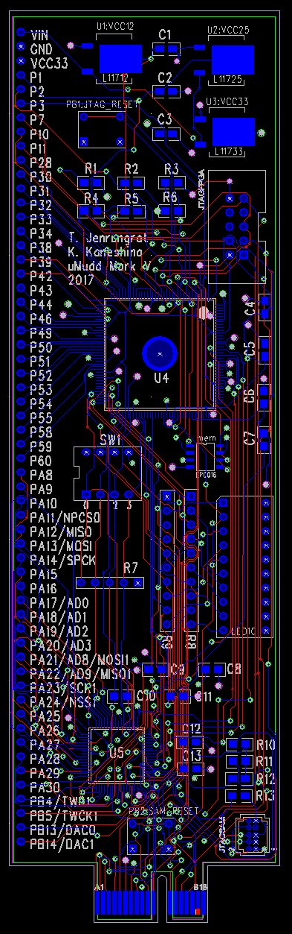
Project Context and Overview
Course currently requires μMudd MkIV and Raspberry Pi 3
Expensive and unbalanced
Solution: integrate an small ARM processor on the μMudd
New features...
SOC/MCU | BCM2837 | ATSAM4B4S
Unit Price | $34.99 (Raspberry Pi 3) | $3.91 (Bare MCU)
Architecture | 64-bit ARMv8 | 32-bit ARMv7M
Core Count | 4 | 1
Frequency | 1200MHz | 120MHz
CoreMark | 12.8/MHz, 15360 total | 3.4/MHz, 408 total
Unique Peripheral Examples | GPU / Ethernet (external on Raspberry Pi) | DAC / ADC / Real-Time Clock / Analog Comparator
https://www.eembc.org/benchmark/reports/benchreport.php?suite=CORE&bench_scores=2758
https://atmelcorporation.wordpress.com/2013/06/24/atmels-sam4s-clinches-highest-coremarkmhz-scores/
https://www.digikey.com/product-detail/en/microchip-technology/ATSAM4S4BA-AUR/ATSAM4S4BA-AUR-ND/5638758
https://www.amazon.com/Raspberry-Pi-RASPBERRYPI3-MODB-1GB-Model-Motherboard/dp/B01CD5VC92

Slide 3
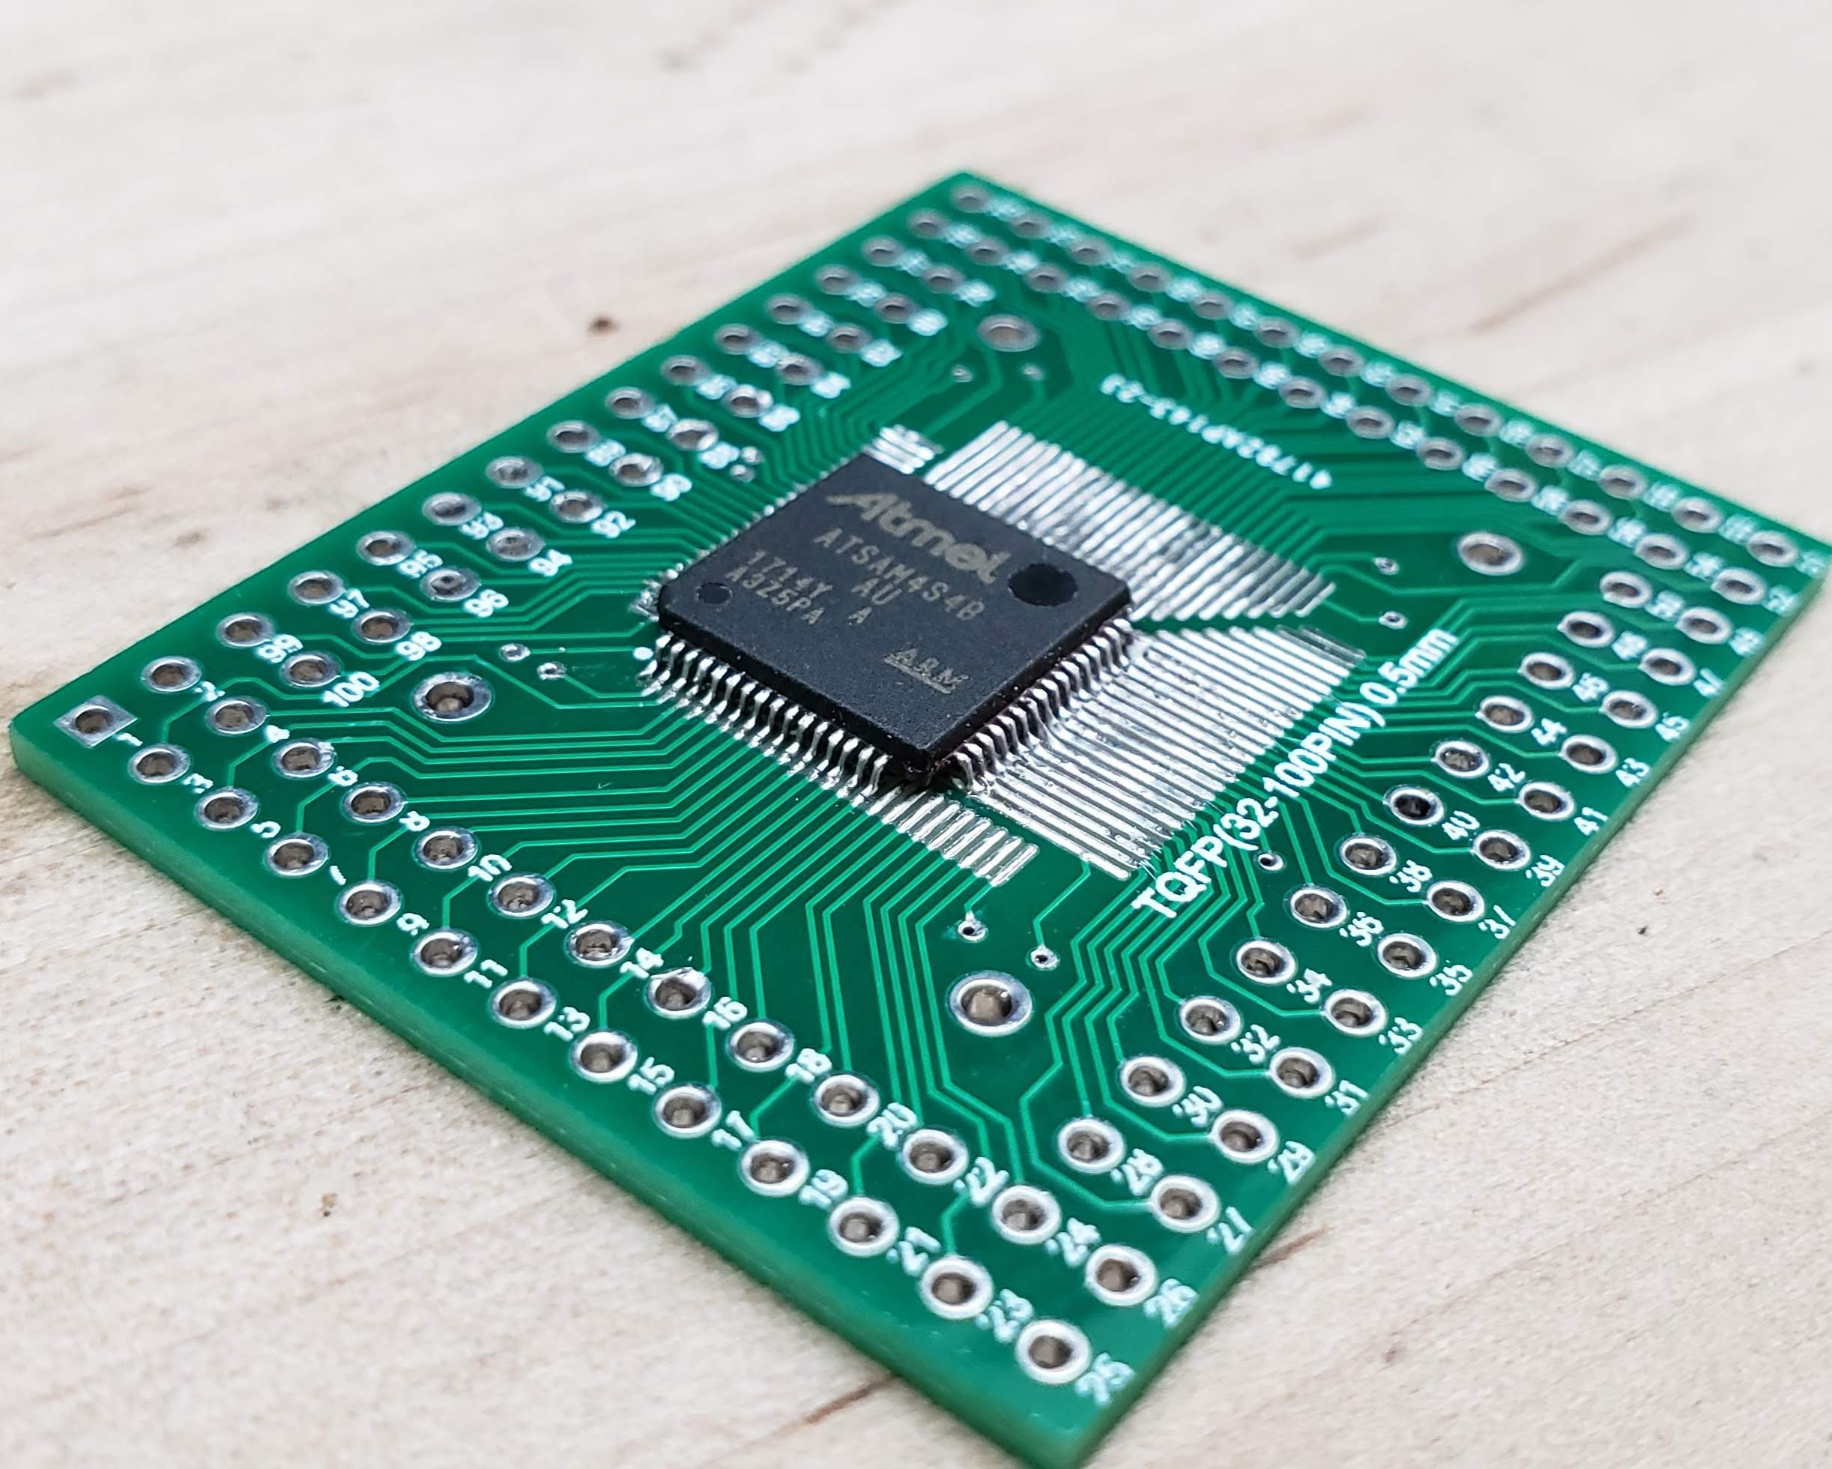
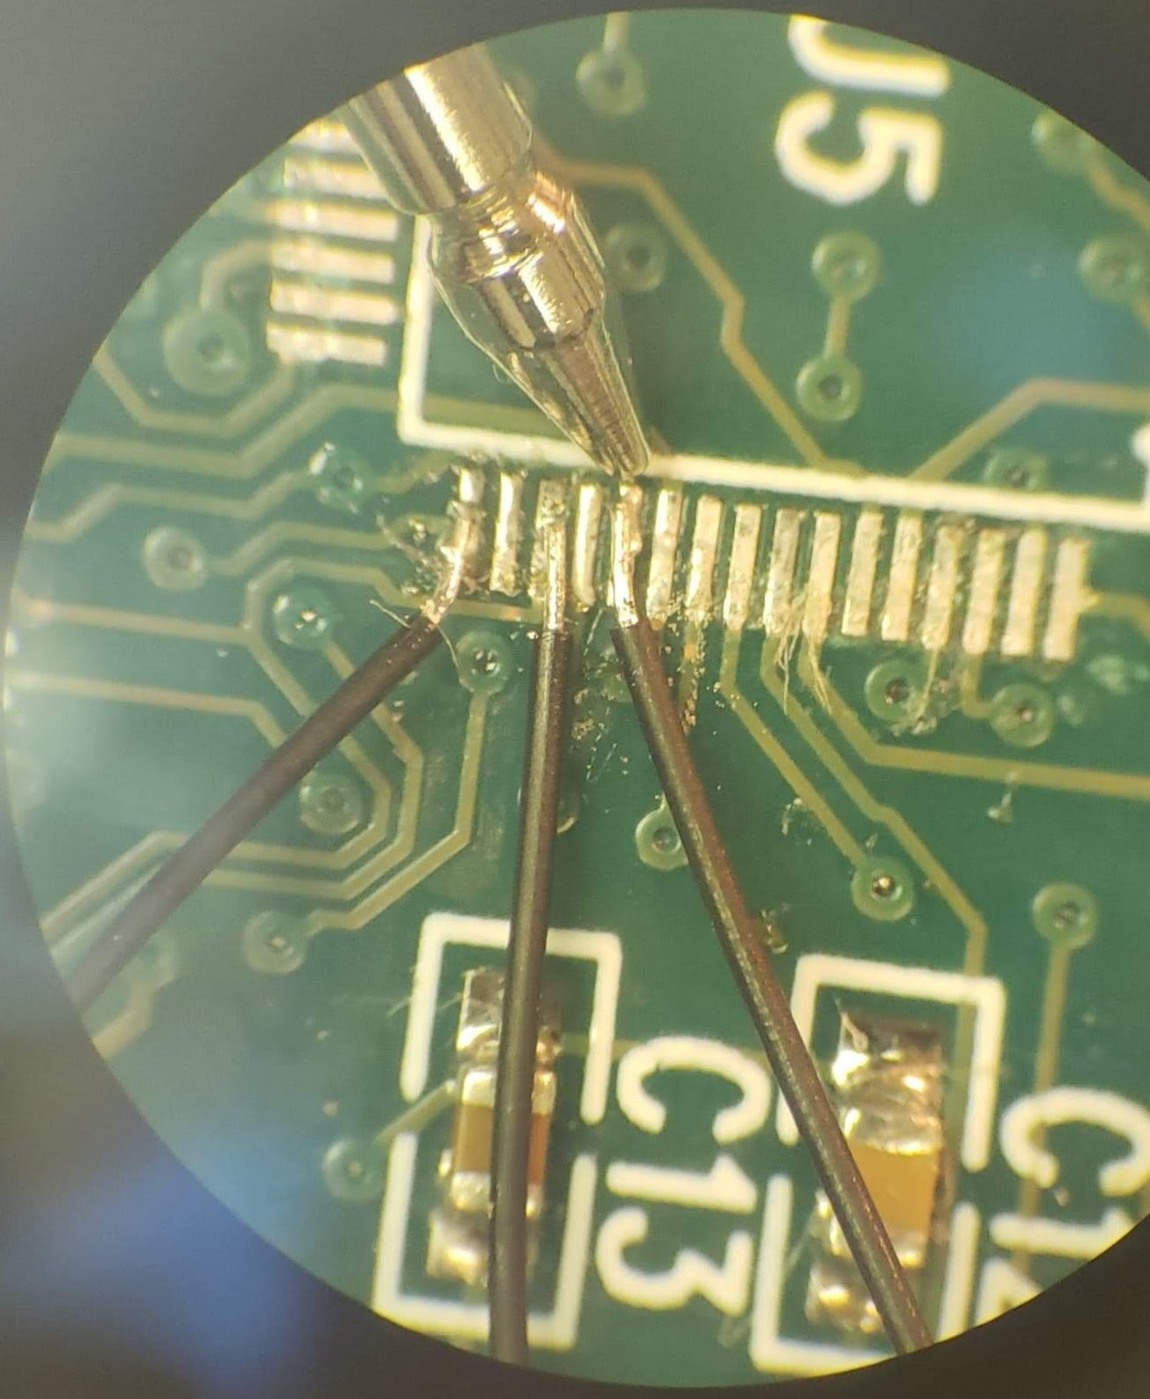
Board Bringup
Nonfunctional MCU
Blocking bugs:
JTAG interface miswired
I2C interface miswired
MCU system ERASE pin pulled high by FPGA
Suboptimal MCU power supply configuration
Board bringup status:
Manually rerouted traces
Can program and execute code
Still unstable
Critical board failure
Schematic revision

Slide 4
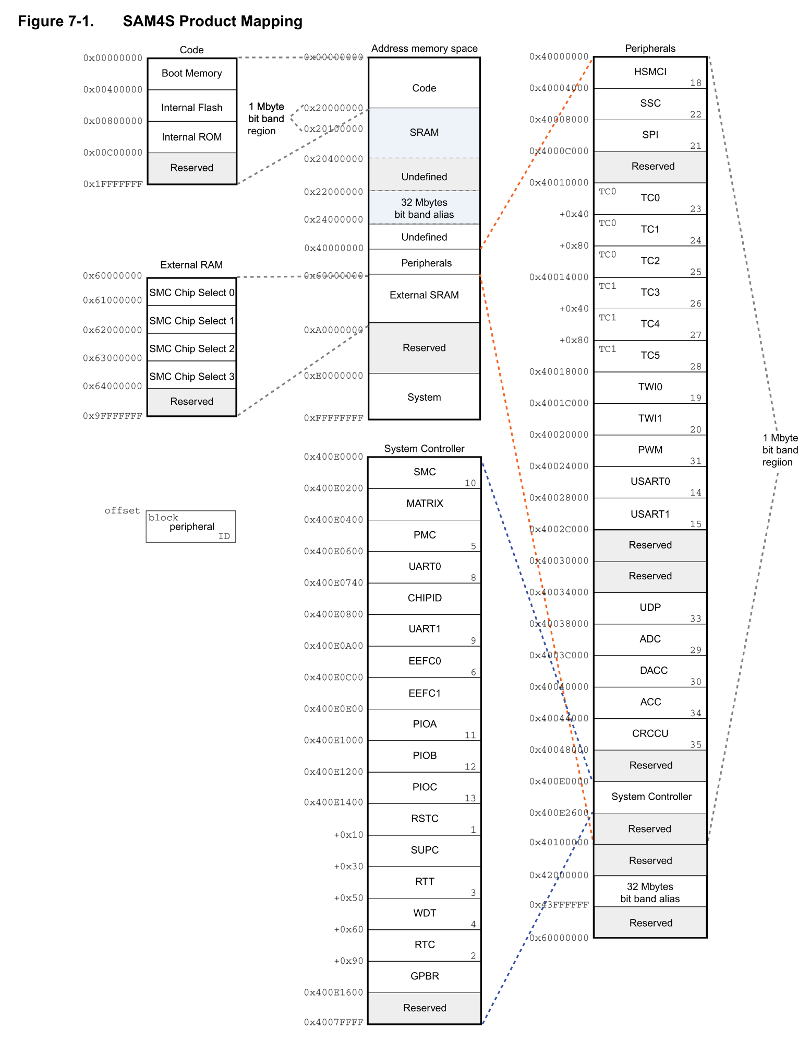
Peripheral Support
Vital peripherals:
PIO (Parallel Input/Output Controller)
TIMER (Programmable Timer and Counter)
SPI (Serial Peripheral Interface)
UART (Universal Asychronous Receiver/Transmitter)
PMC (Power Management Controller)
Startup Routines:
Clock initialization and routing to peripherals
Disabling write protection on special function registers
Defining the memory map and board-specific constants
Benefit of ATSAM4S4B: a well-documented datasheet!

Slide 5
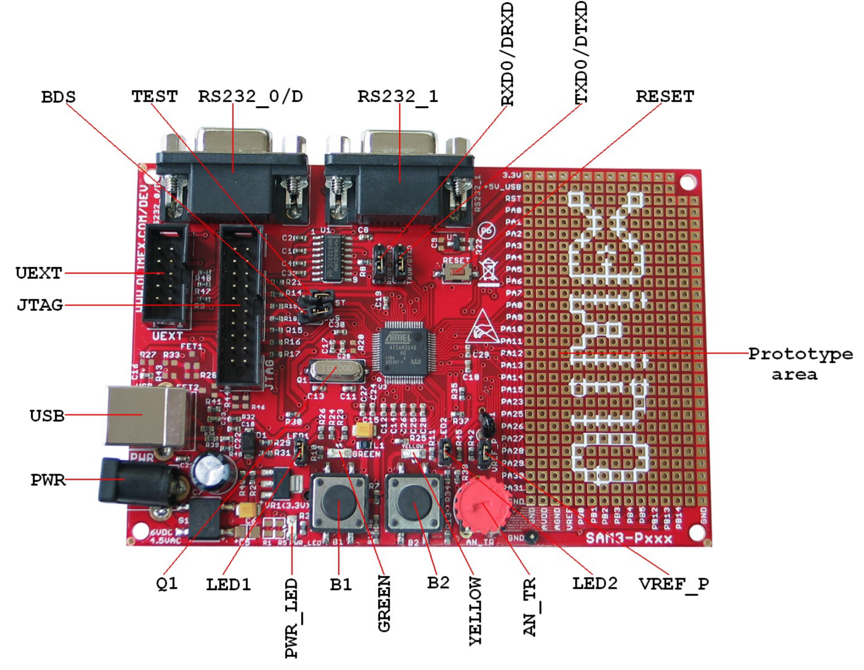
Peripheral Bringup
Using an Olimex SAM3-P256 development board to test and bring up peripheral functionality.
ATSAM3S4B MCU has same peripheral set and memory map as ATSAM4S4B.
JTAG interface allows for real-time access to memory and easy programming from an IDE.
Built-in LEDs and breakout area are convenient for quickly building test circuits.
http://www.farnell.com/datasheets/1697933.pdf
Notes:
http://www.farnell.com/datasheets/1697933.pdf

Slide 6
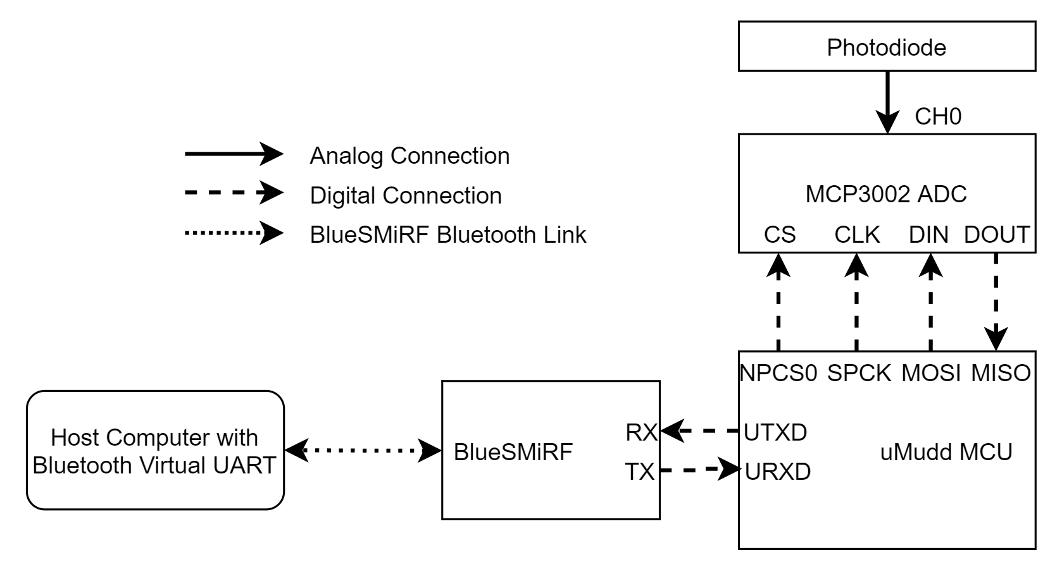
Technical Problem: Lab 6 Revision
MCU can’t run Linux or Apache natively, so Lab 6 must be redesigned.
Previous versions of Lab 6 used a BlueSMiRF (transparent serial over Bluetooth)
New version combines SPI, UART, and Bluetooth to emulate current Lab 6:

Slide 7
Feedback: Board and Lab
μMudd Revision Features
 | 𝛍Mudd MkIV | 𝛍Mudd MkV
MCU | External RPi 3 Cortex-A57 | ATSAM4S Cortex-M4
Analog Interfaces | MCP3002 ADC | MCU ADC / DAC / Analog Comparator
Motor Drivers | 4 H-bridges with screw terminals | None
FPGA Clock | 40MHz Oscillator | Provided by MCU
Test Features | None | External MCU / FPGA Test Board
We’d love to hear your ideas about…
...what you would like to see from lab 6.
...what you would like to see from the new board.
...your general thoughts about this redesign.
Lab 6 Revision Features
 | Current Lab 6 | Revised Lab 6
Lab Goal | IoT LED control and light intensity measurement | Bluetooth light intensity measurement
External Sensors | LPT2023 phototransistor | LPT2023 phototransistor
Networking | Hosting HTTP server | Bluetooth data transmission
MCU Peripherals | SPI | SPI, UART

Slide 8
